Slide 1
Title: Climate change(Weather)
Problem Definition: How is the weather changing in key locations across the UK?
Temperature has been rising ever than before in the Uk.

Slide 2
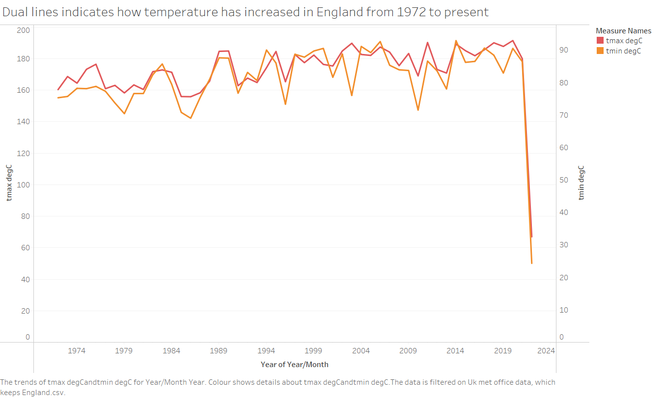

Slide 3
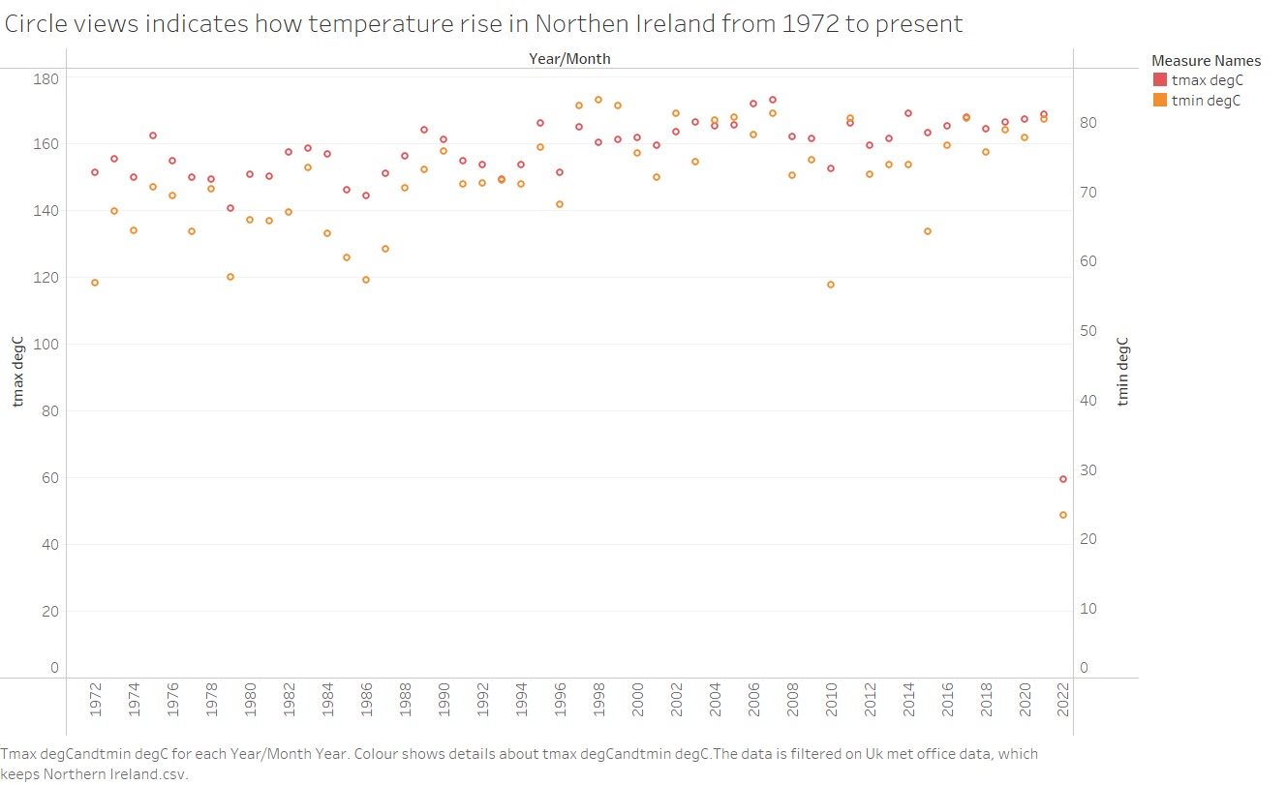

Slide 4
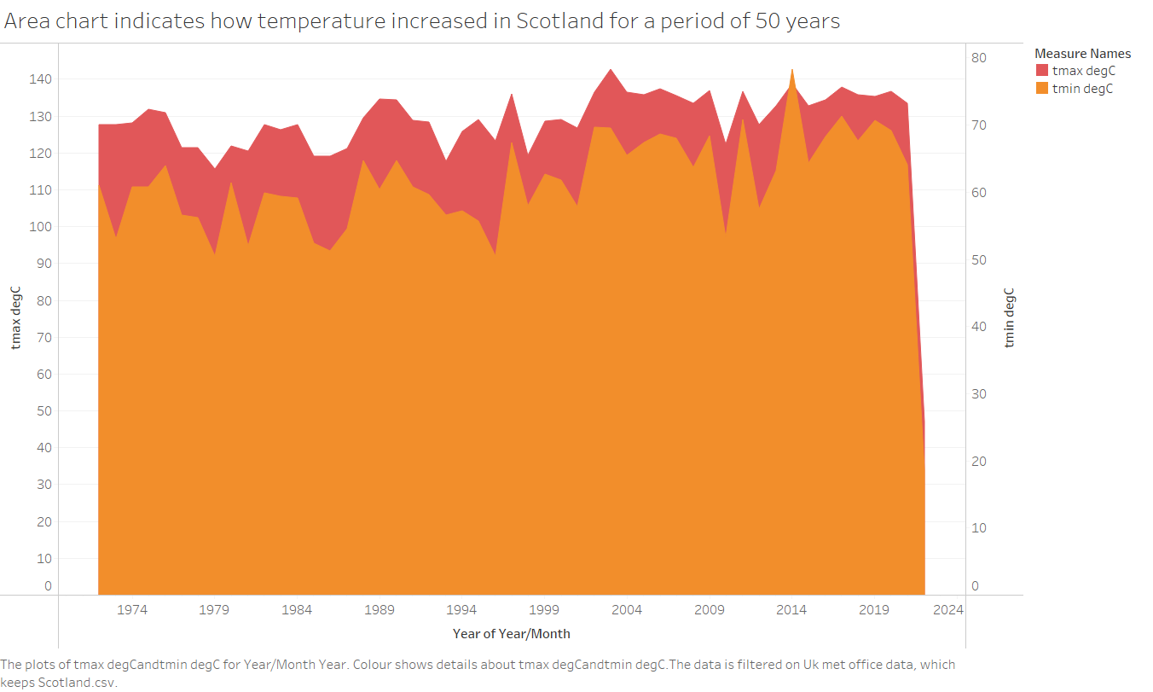

Slide 5
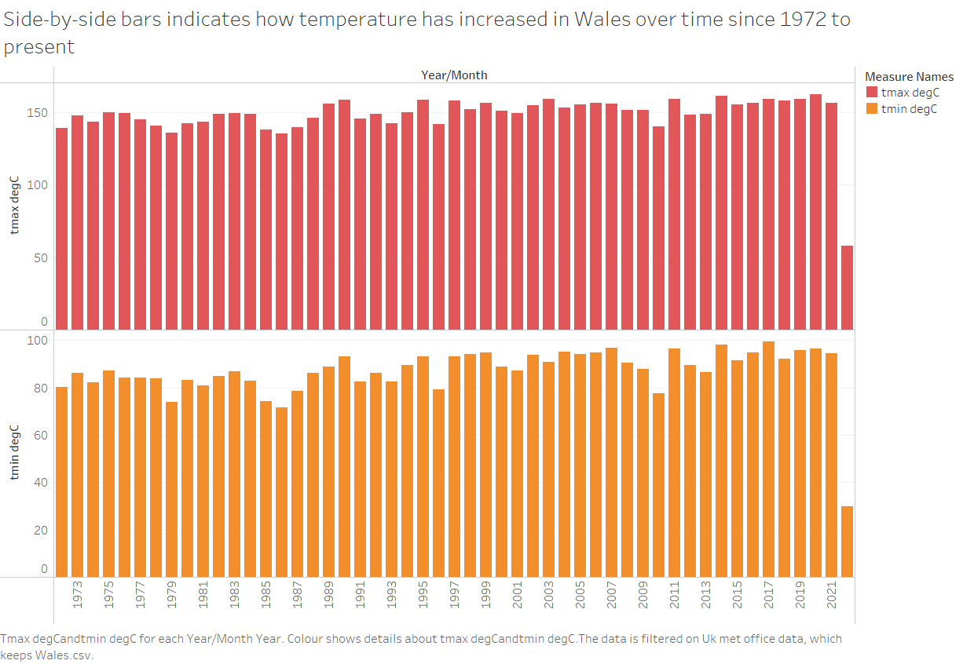

Slide 6
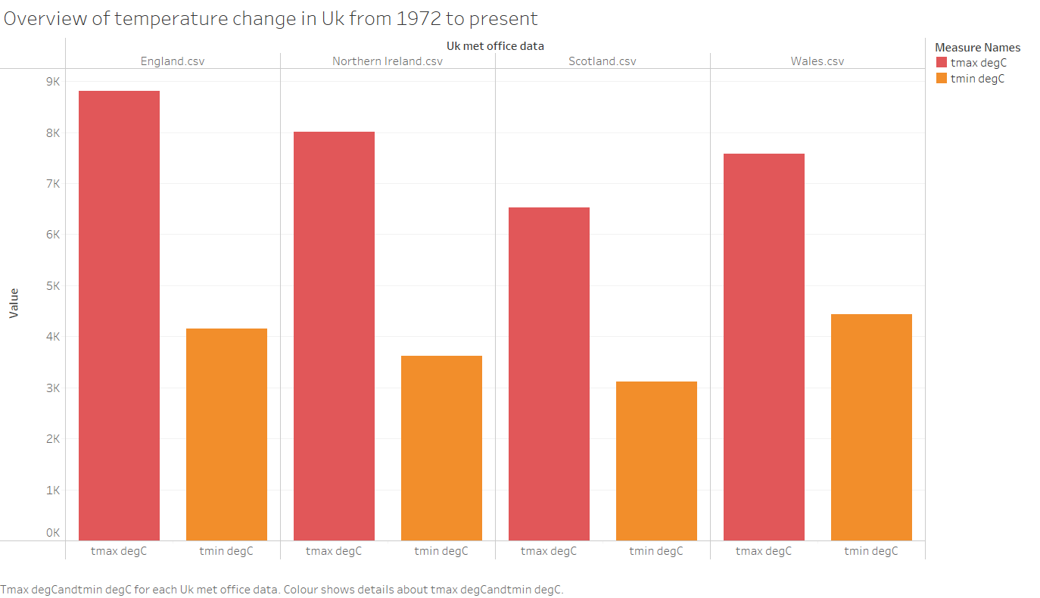

Slide 7
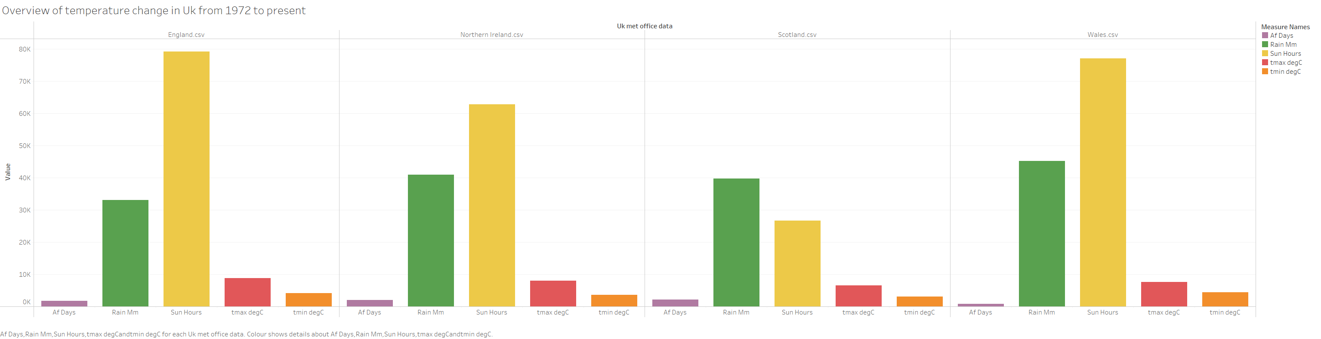

Slide 8
Data analysis
Significant increase in temperature across the Uk.
England recorded the highest temperature and sun hours.
Scotland recorded the lowest temperature, lowest sun hours and highest air frost days.
Wales recorded the highest Rain measured in millimetres.

